Slide 1

Unity 3D Essentials
Unity Package Manager
SoftUni Team
Technical trainers
Software University
https://softuni.org

Slide 2

Table of Contents
Introduction
Test Framework
Input System
Localization
HDRP/URP

Slide 3
Have a Question?
sli.do
#Unity3D-Basics
Notes:
‹#›

Slide 4

Introduction

Slide 5
Introduction
Unity decided to make all official Unity packages packages centrally located and create the Unity Package Manager
Shortly called UPM
Package - container that holds any combination of Assets, Shaders, Textures, plug-ins, icons, and scripts that enhance various parts of a project.

Slide 6
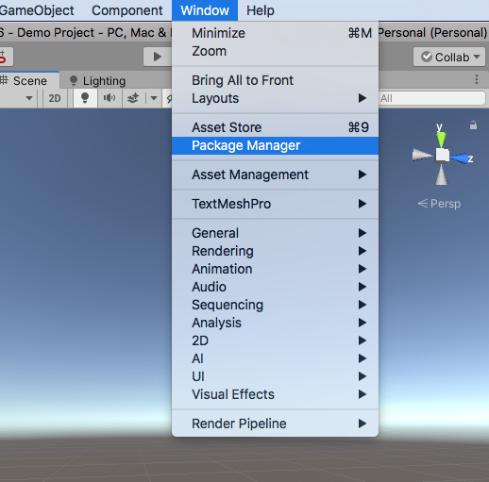
Getting started
Open Window -> Package manager
Packages type filter
Unity Registry
In Project
My Assets
Built-in
Add new local package button (+)

Slide 7

Input System

Slide 8
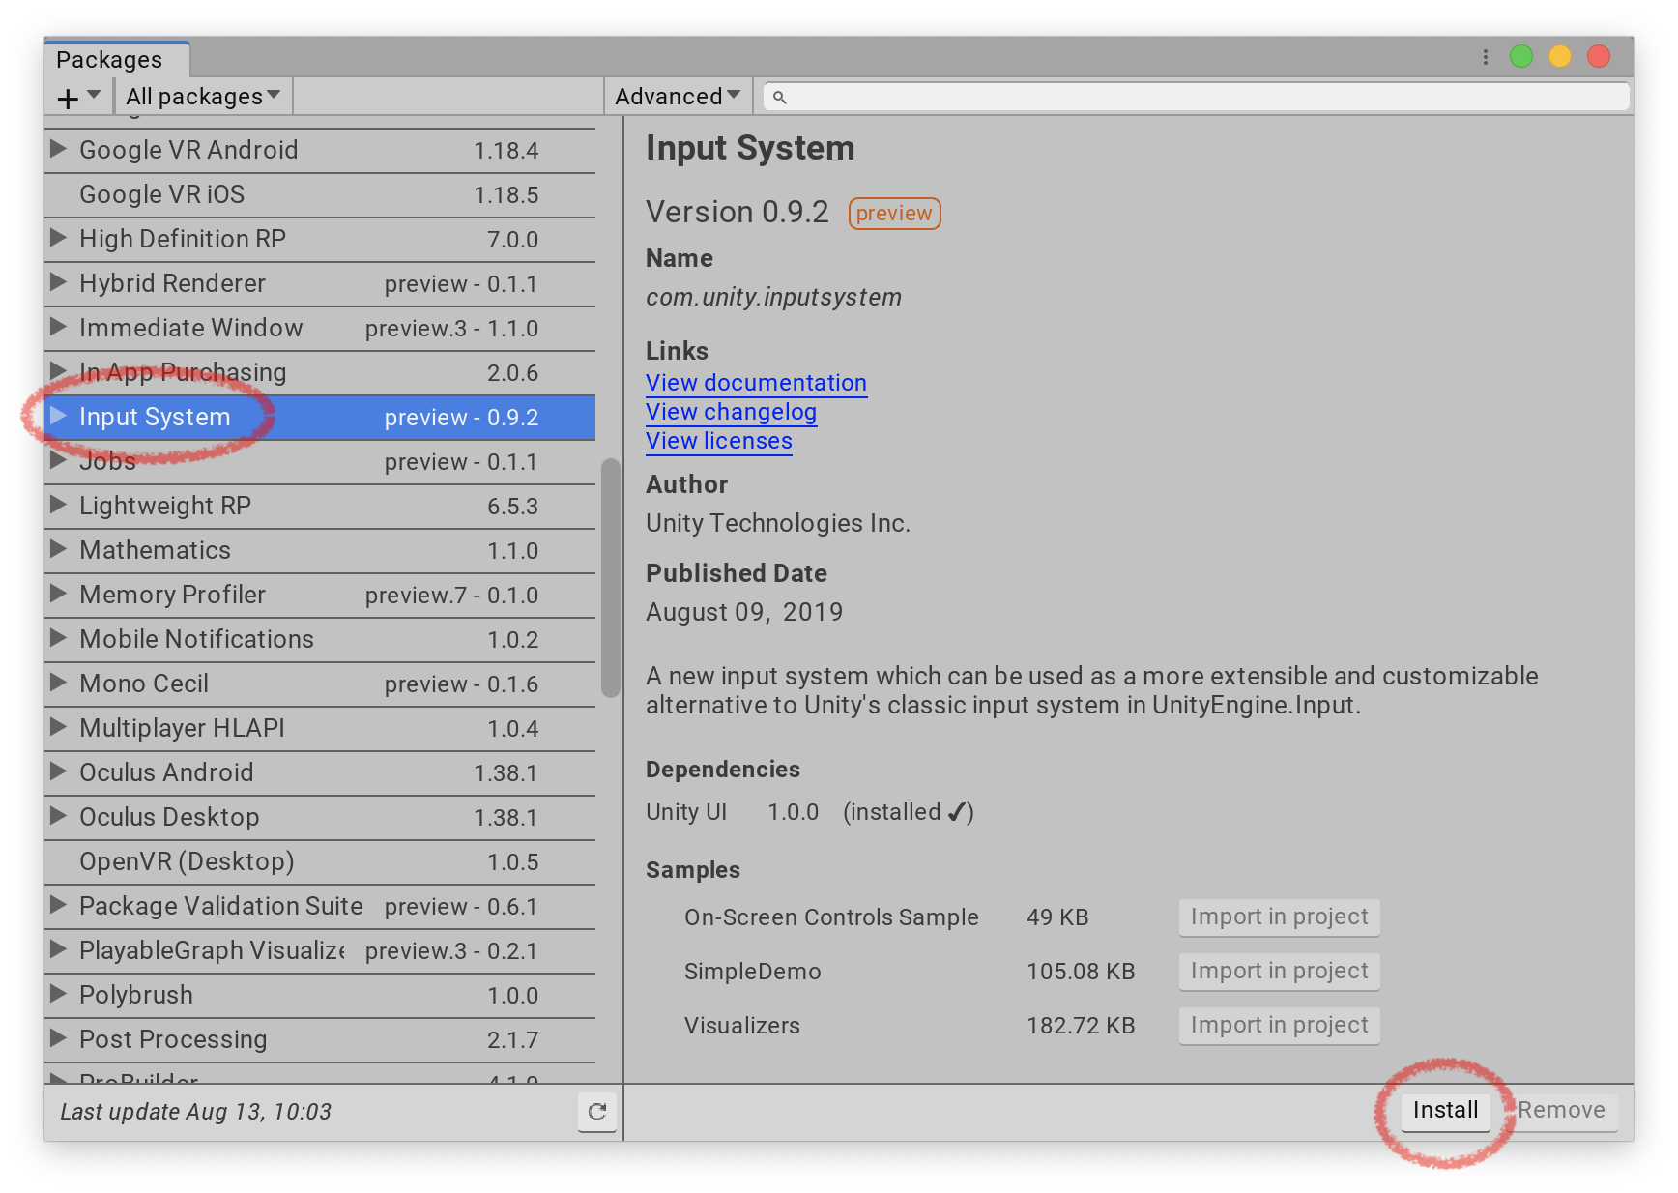
Input System
Control any kind of Input Device
powerful, flexible, and configurable
Replacement for Unity's classic Input Manager (UnityEngine.Input class)

Slide 9

Demo

Slide 10
Test Framework (UTF)

Slide 11
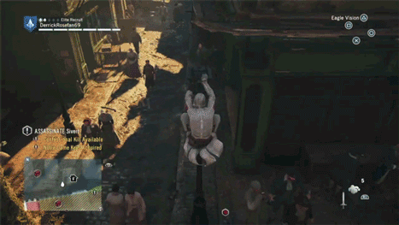
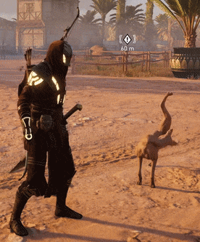
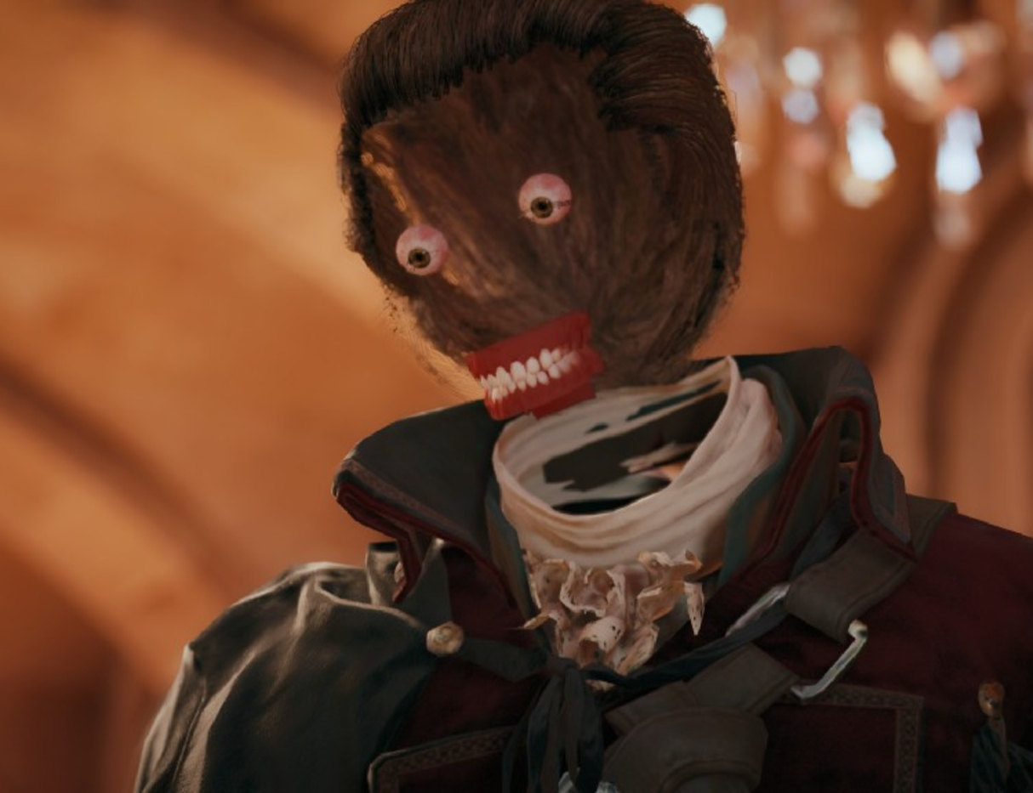
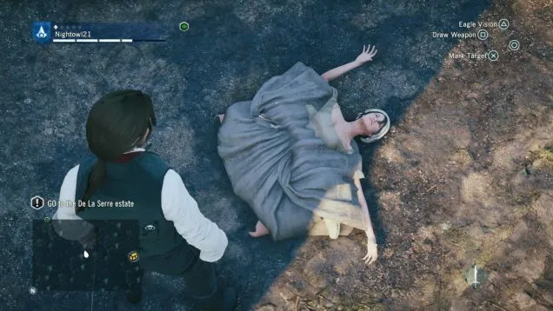
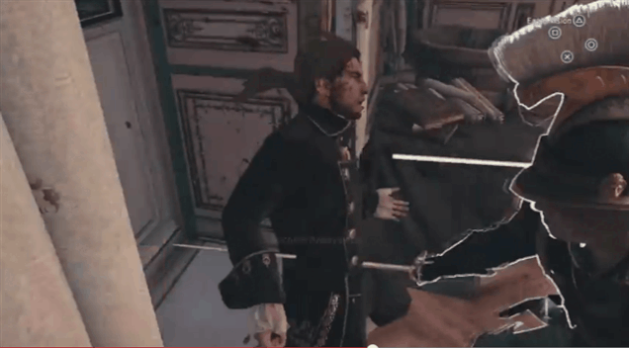
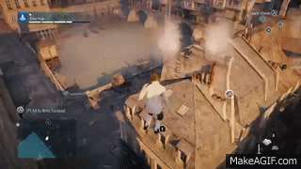
Assassin’s Creed Unity Budget: $100 million + No time for tests…
Test your game!

Slide 12
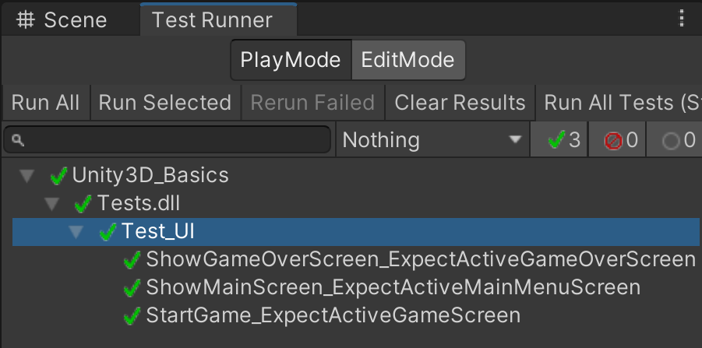
Introduction
Test project code
Edit Mode
Play Mode
Target platforms such as Standalone, Android, iOS etc.
Use NUnit (open-source unit testing library for .Net)
Warning: Wrap the game logic into Assembly definition file. Link it to the test Framework

Slide 13
Demo

Slide 14
Localization

Slide 15
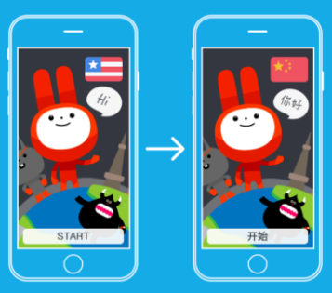
Introduction
localization settings for your application
support for multiple languages
String localization
Asset localization (Texture, model, Audio)
Import/export localization data (XLIFF/CSV/Google Sheets)

Slide 16
Demo

Slide 17
HDR/URP

Slide 18
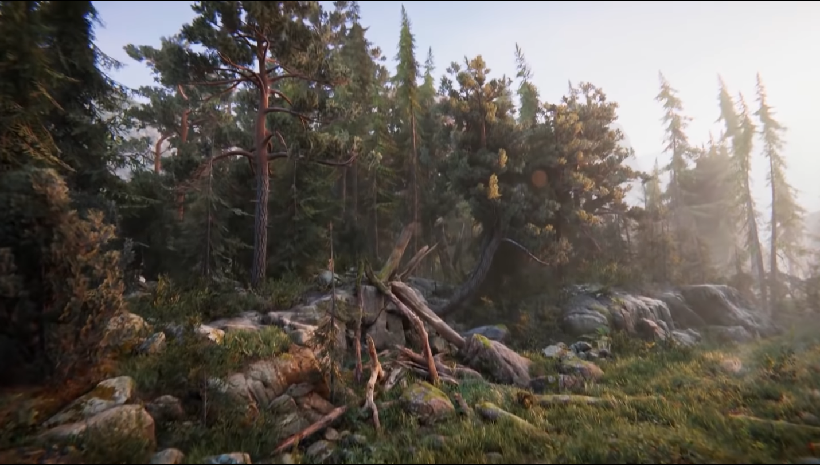
HDRP/URP
high-fidelity Scriptable Render Pipeline built by Unity to target modern (Compute Shader compatible) platforms.
Physically-Based Lighting techniques, linear lighting, HDR lighting, and a configurable hybrid Tile/Cluster deferred/Forward lighting architecture.

Slide 19
Demo

Slide 20
Useful Links
Input System official page
Test Framework official page
Localization official page
High Definition Render Pipeline page
Universal Render Pipeline page
HDRP vs URP explanation

Slide 21

Summary
Introduction
Test Framework
Input System
Localization
HDRP/URP
Notes:
‹#›

Slide 22
Questions?
Email : dstrashilov@gmail.com
Notes:
‹#›

Slide 23

License
This course (slides, examples, demos, exercises, homework, documents, videos and other assets) is copyrighted content
Unauthorized copy, reproduction or use is illegal
© SoftUni – https://about.softuni.bg
© Software University – https://softuni.bg
Notes:
‹#›

Slide 24
Trainings @ Software University (SoftUni)
Software University – High-Quality Education, Profession and Job for Software Developers
about.softuni.bg, softuni.org
Software University Foundation
softuni.foundation
Software University @ Facebook
facebook.com/SoftwareUniversity
Software University Forums
forum.softuni.bg
Notes:
‹#›

